Slide 1
Biosensing 2.0
Team Members: Galo Romero, Jordan Laing Product Owner: Dr. Shekhar Bhansali
Instructor: Masoud Sadjadi School of Computing and Information Sciences Florida International University
Final Presentation
Spring 2017
Notes:
7 seconds.( I will select 2 best slides (i will give them extra points and students will present for CIS committee)
Greet your audience, thank them for attending your presentation, introduce yourself, introduce your project, introduce your team members, and quickly indicate what each of you did in a high-level manner, and put more emphasis on your part/contribution.

Slide 2
Project definition
Problem:
Doctors would like to monitor their patient’s health continuously and remotely.
Doctors want to store and process their patient’s data.
Patients would like to see their health related data in a clear manner.
Notes:
10 seconds.
Introduce the problem that the whole project (in all versions) tackles with GIF or screenshot.

Slide 3
Project definition
Solution:
Develop mobile and server applications for data retrieval.
Data is retrieved from a biosensor device.
Data is to be stored, analyzed; and displayed after processing.
Notes:
20 seconds.
Introduce the problem that the your project (in new version) tackles with GIF or screenshot.

Slide 4
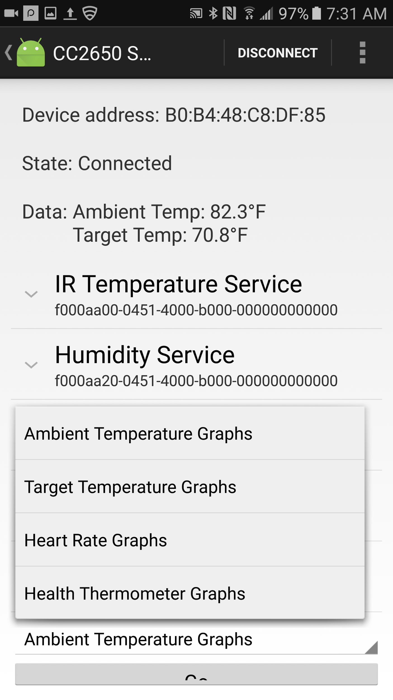
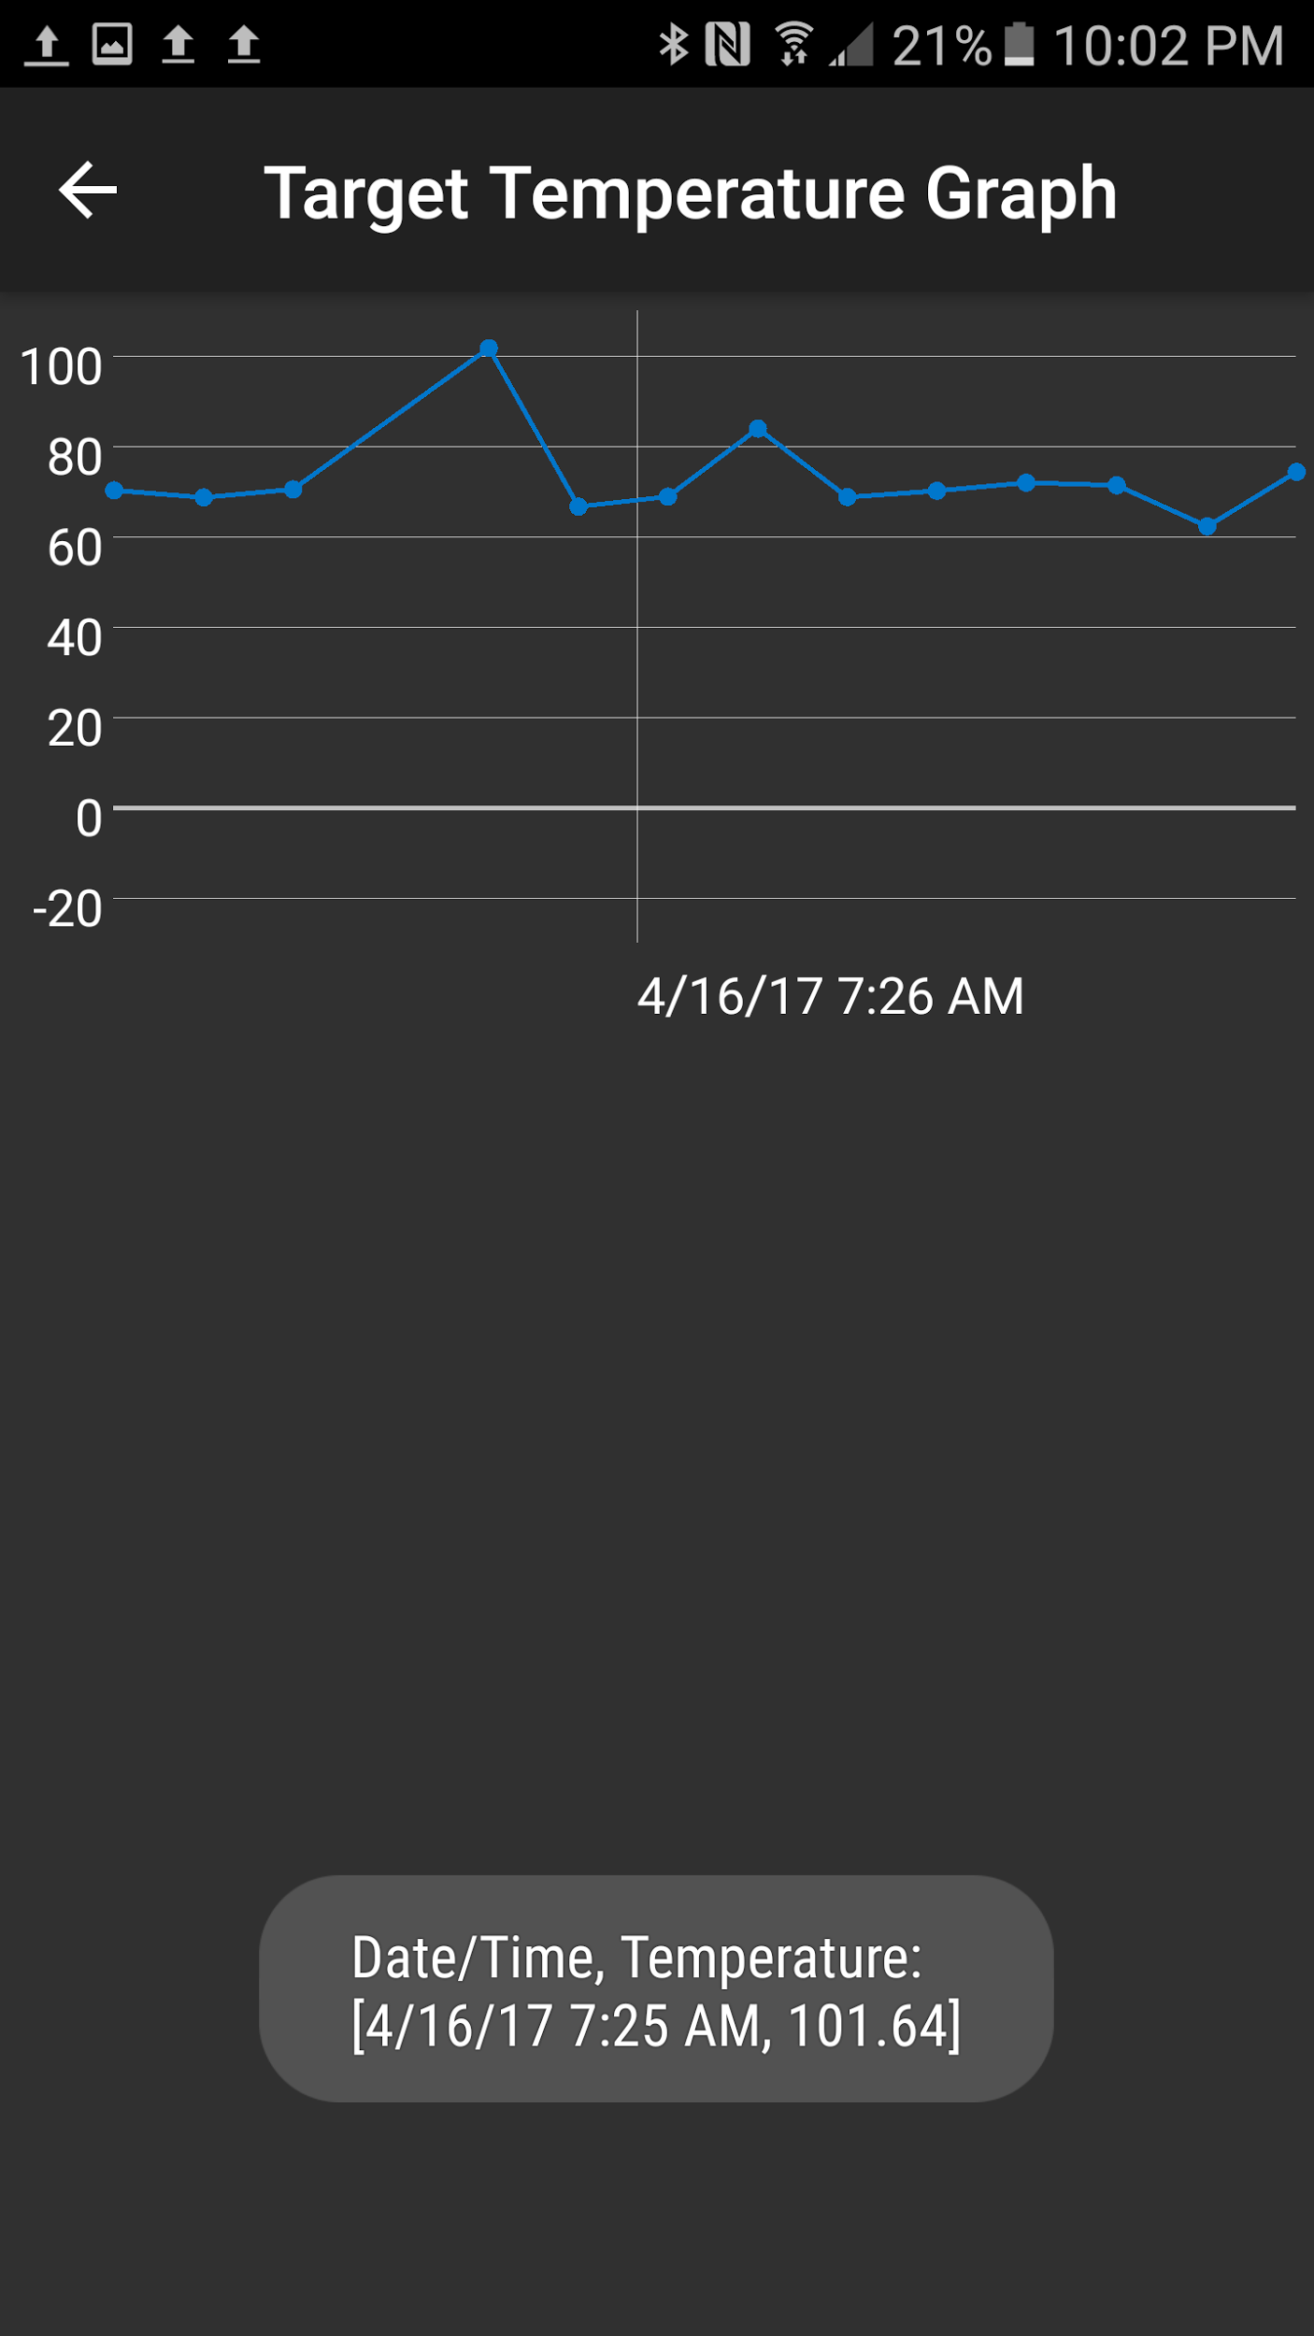
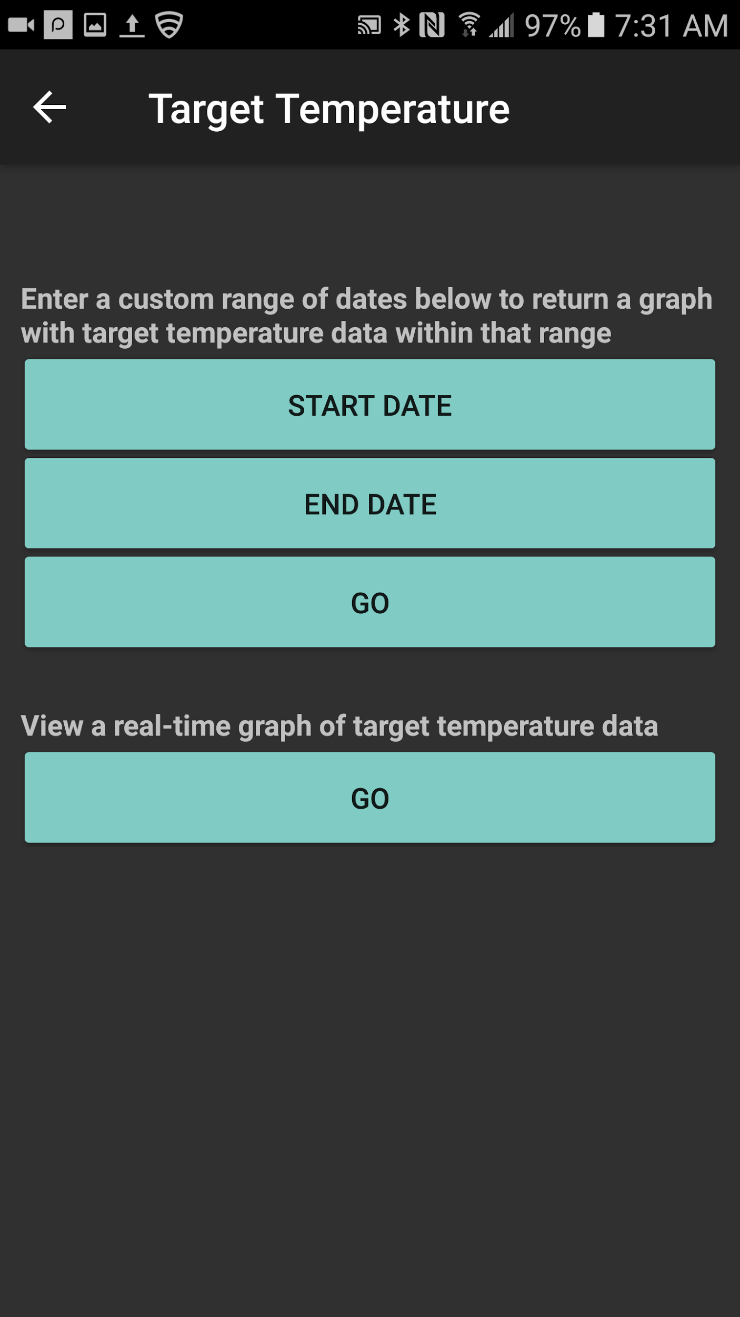

Slide 5
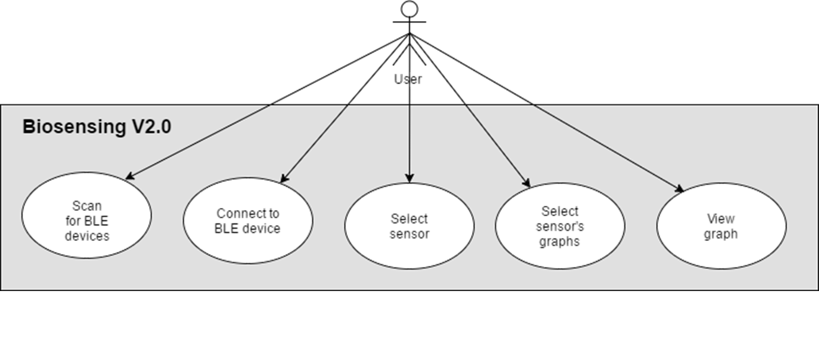
Requirements: Use Cases
Notes:
5 seconds
Show the Use Case Diagram for the whole project. Highlight your use cases.

Slide 6
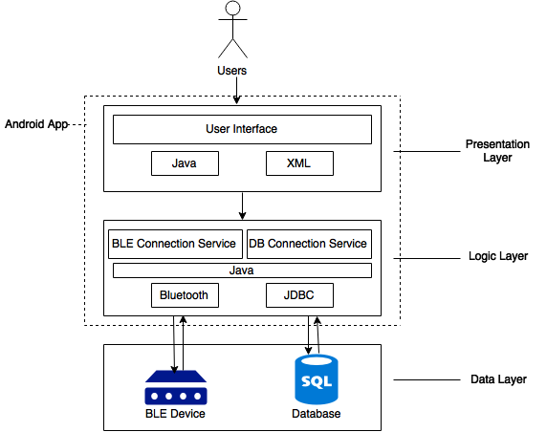
System Design: Architecture
Notes:
20 seconds
System design: Highlight the parts that you contributed to them.
1. System decomposition; identify the architecture patterns used
2. System deployment – h/w and s/w requirements

Slide 7
System Design: Deployment

Slide 8
Minimal Class Diagram
Notes:
10 seconds.Minimal class diagram. Highlight the classes that you created/modified
Identify the design patterns used (one or more slides).

Slide 9
User Stories
1. 229 - Merge modules into finished app.
2. 185 - Connect Android app to BLE device.
3. 207 - Integrate MS SQL Server with R services.
4. 225 - Add capability to gather and display data from Sunny device.
5. 216 - Pull data from server and display in graph.
Notes:
5 seconds.
List the user stories that you worked on them.(put in order of importance). Stay focused on the parts that you have been working.

Slide 10
User Story #229
As a developer, I want to merge the BLE connectivity module with the server connectivity/data display module into a single app.
Integrating two Android apps necessitated a lot of small and tedious changes, like to the pages’ theme
Looking back, I should have implemented a SQLite database that was stored on the phone itself; would allow the use of the app even without an Internet connection
Notes:
60 seconds
The tile of user story
The most important user story you worked on it. You have to describe this one very well and be proud of that.
Please present and show the complexity of your work, code, algorithms, and technical challenges and technologies you have used. (you could use screenshot if you want. Visual presentations are better than text presentation)
Go into the details of the most important/significant tasks using bullet lists or visual graphs or state chart diagram
Sequence Diagram for this user story is mandatory (in another separate page if required)
Demo using screenshots or GIF (in another separate page if required)

Slide 11
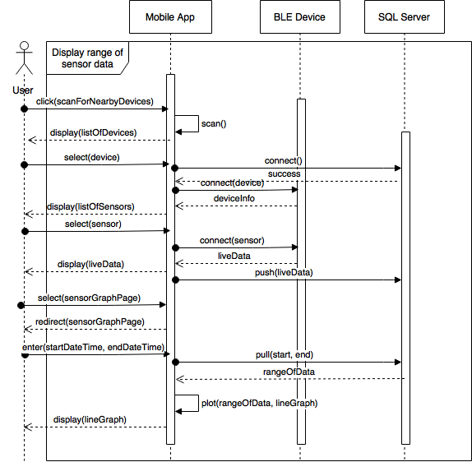
Sequence Diagram for User Story #229

Slide 12
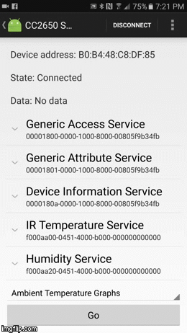
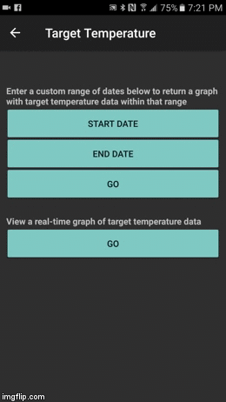
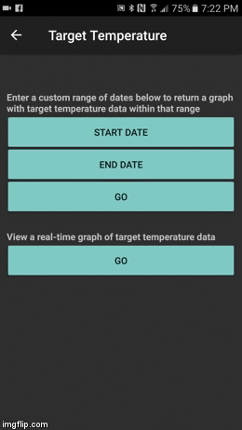
Demonstration

Slide 13
User Story #185
As a user, I want to connect to BLE device, so that, doctors and myself can monitor my heart rate, alcohol level, sugar level, etc.
Notes:
20 seconds
The tile of user story
Please present and show the complexity of your work, code, algorithms, and technical challenges and technologies you have used. (you could use screenshot if you want. Visual presentations are better than text presentation) - Go into the details of the most important/significant tasks using bullet lists or visual graphs or state chart diagram - Demo using screenshots or GIF (in another separate page if required)
Sequence Diagram for this user story is optional

Slide 14
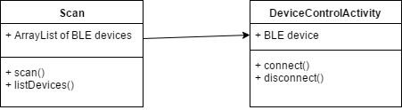
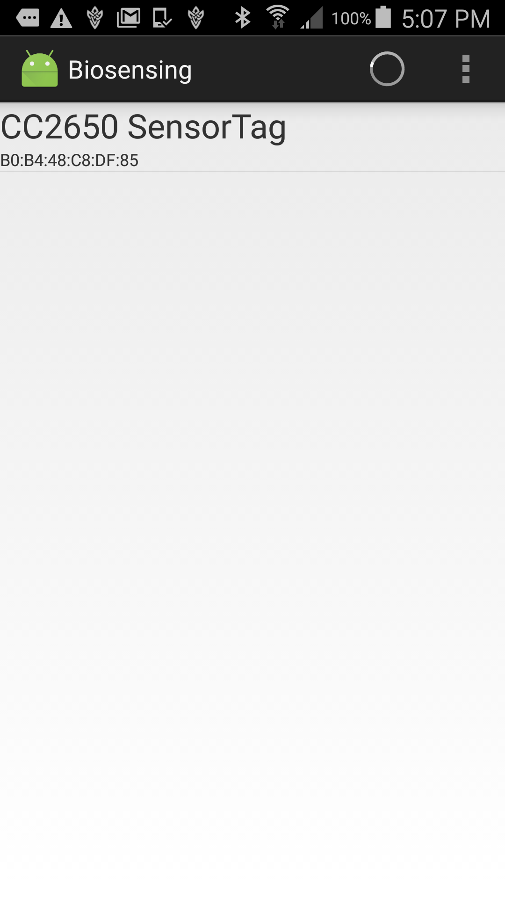
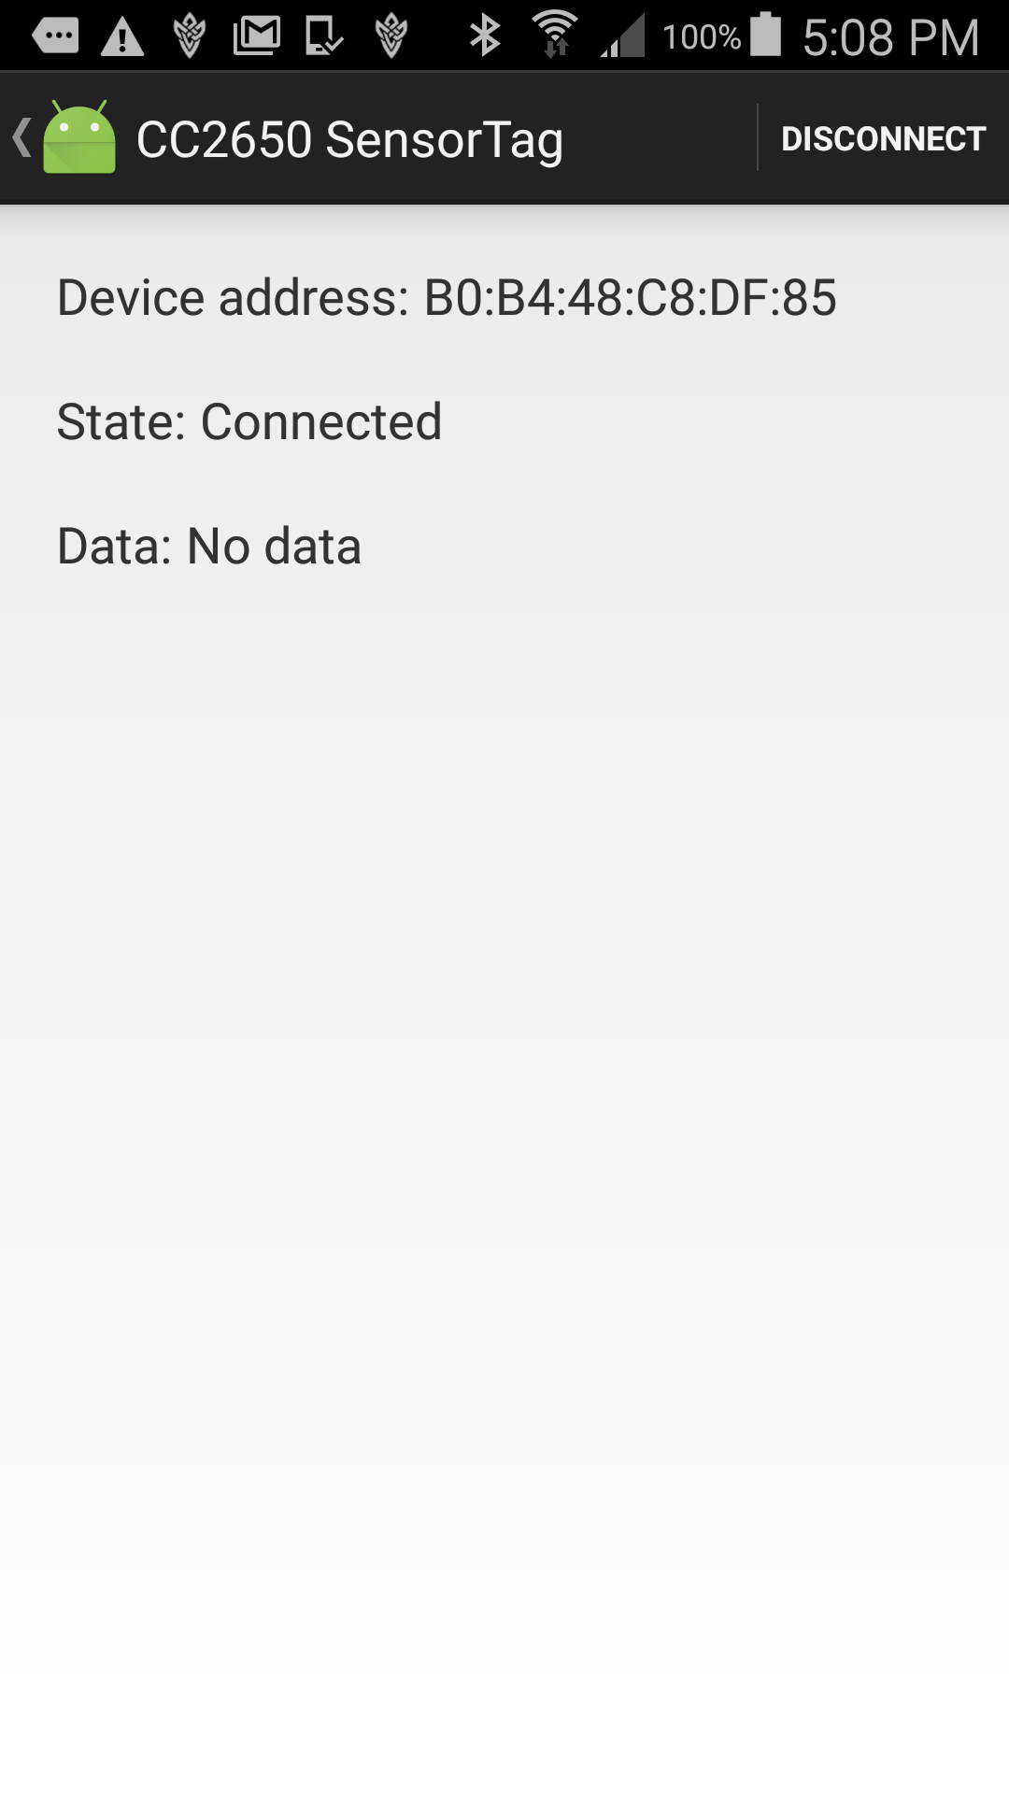
Class Diagram for User Story #185

Slide 15
User Story #207
As a user, I want to be able to send data that the app collects to the server.
Switched database server from MySQL to MS SQL Server
Tried to integrate R services, but had problems with installation
This led to more of the workload being done on the app
Notes:
20 seconds
The tile of user story
Please present and show the complexity of your work, code, algorithms, and technical challenges and technologies you have used. (you could use screenshot if you want. Visual presentations are better than text presentation) - Go into the details of the most important/significant tasks using bullet lists or visual graphs or state chart diagram - Demo using screenshots or GIF (in another separate page if required)
Sequence Diagram for this user story is optional

Slide 16
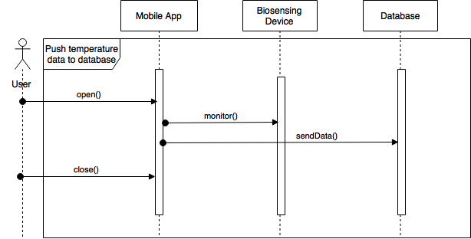
Sequence Diagram for User Story #207

Slide 17
User Story #225
As an app developer, I want to gather and display data from the Sunny device, so that, patients can see their heart rate and temperature.
Notes:
20 seconds
The tile of user story
Please present and show the complexity of your work, code, algorithms, and technical challenges and technologies you have used. (you could use screenshot if you want. Visual presentations are better than text presentation) - Go into the details of the most important/significant tasks using bullet lists or visual graphs or state chart diagram - Demo using screenshots or GIF (in another separate page if required)
Sequence Diagram for this user story is optional

Slide 19
User Story #216
As a user, I want to be able to view data that has been stored on the server in a graph.
Separated app into two subsystems - one that communicates with the BLE device and one that communicates with the database server
Working independent of BLE device
Notes:
20 seconds
The tile of user story
Please present and show the complexity of your work, code, algorithms, and technical challenges and technologies you have used. (you could use screenshot if you want. Visual presentations are better than text presentation) - Go into the details of the most important/significant tasks using bullet lists or visual graphs or state chart diagram - Demo using screenshots or GIF (in another separate page if required)
Sequence Diagram for this user story is optional

Slide 20
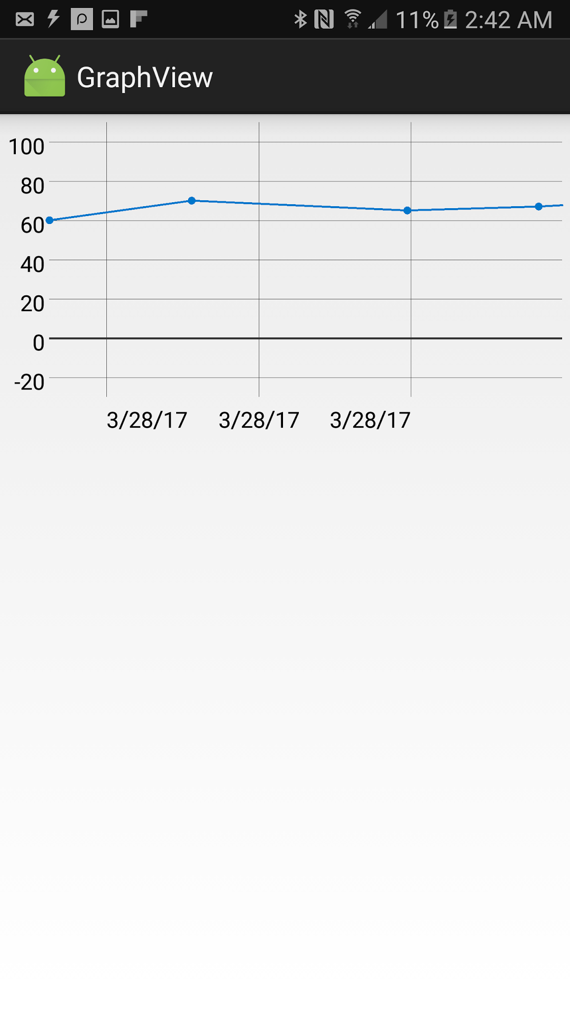
Sequence Diagram for
User Story #216

Slide 21
Test Cases
Test Case ID: 229-001 (Sunny Day)
Purpose: To test if the mobile app can connect to a BLE biosensing device’s sensors, store the data it collects in a server, and display graphs with data pulled from the server
Preconditions:
- Android application package installed on mobile device - SQL Server running on same local network as mobile device - A BLE biosensing device (such as the T.I. SensorTag) is nearby and turned on
Expected Result: -The app connects to the device’s temperature sensor and pushes the data to the server every 30 seconds - The app displays a user-given range of temperature data in a line graph
Actual Result: - The app successfully connects to the T.I. SensorTag’s temperature sensor and pushes temperature data to the server every 30 seconds. - The app successfully displays a line graph with that sensor’s data within the range of date and times the user specifies
Notes:
10 seconds
A description of verification process and Test Suites and Test Cases for one of the use cases.
1 One sunny day and one rainy day for the implemented use cases (one or more slides).
2 Automated test scripts for the implemented use cases (if any) (one or more slides).

Slide 22
Test Cases
Test Case ID: 199-002 (Rainy Day)
Purpose: To test what happens if the app correctly displays data from unknown UUIDs.
Preconditions:
- Android application package installed on mobile device - App is open and connected to an unknown BLE device
Expected Result: - The app data displays data in hexadecimal format.
Actual Result: - The app successfully displays data in hexadecimal format.

Slide 23





Summary
Biosensing - an IoT app to aid in health monitoring for both individuals and professionals
Developers:
Jordan Laing - jordanlaing7@gmail.com - linkedin.com/in/jordanlaing7
Galo Romero - grome014@fiu.edu
Questions?
Thank You!
Notes:
10 seconds
Summarize your contribution, mention your effort for Scrum, Mingle, Github, Google Drive Documentation and minutes
Include your contact information
Ask if anyone has any questions for you.
Thank your audience

